Slide 1
SECURE DATA HIDING IN IMAGES USING STEGANOGTAPHY
CAPSTONE PROJECT
Presented By:
Student Name : BAISHAYAN SAHA
College Name & Department : HERITAGE INSTITUTE OF TECHNOLOGY
ECE

Slide 2
OUTLINE
Problem Statement
Technology used
Wow factor
End users
Result
Conclusion
Git-hub Link
Future scope

Slide 3
Problem Statement
In the digital age, secure communication is paramount, especially when transmitting sensitive information. Traditional encryption methods protect data but often make it obvious that something is being hidden. This project focuses on steganography, a technique that hides secret data within an image, making it undetectable to the naked eye. The goal is to develop a secure data-hiding system using steganography, where a secret message is embedded into an image and can only be extracted with the correct passcode, ensuring both confidentiality and stealth in data transmission.

Slide 4
Technology used
For the steganography project described, the following libraries and technologies are used:
OpenCV (cv2):
Used for reading and writing image files, as well as manipulating pixel values to embed and extract the secret message.
Python Standard Libraries:
os: Used for system-level operations, such as opening the encrypted image file after creation.
string: Provides utilities for working with strings, though it is not heavily utilized in this script.
Technologies:
Steganography: The core technique used to hide data within the pixel values of an image.
ASCII Encoding: Used to map characters to their corresponding integer values and vice versa for embedding and extracting messages.
These libraries and technologies form the foundation of the project, enabling the embedding and extraction of secret messages within images while maintaining a simple and effective implementation.

Slide 5
Wow factors
This steganography project stands out from others due to the following unique features:
Passcode Protection:
Unlike many basic steganography implementations, this project incorporates a passcode-based authentication system for decryption. Only users with the correct passcode can extract the hidden message, adding an extra layer of security.
Simple and Lightweight:
The project uses minimal dependencies (only OpenCV and Python's standard libraries), making it easy to set up and run on any system without requiring complex installations.
Pixel-Level Embedding:
The secret message is embedded directly into the RGB pixel values of the image, ensuring that the hidden data is distributed across the image in a way that is invisible to the naked ey
4. Stealthy Data Hiding:
By embedding the message directly into the image, the project ensures that the presence of hidden data is not easily detectable, making it suitable for secure and covert communication.
These features make the project user-friendly, secure, and adaptable, setting it apart from simpler steganography implementations that lack authentication or are harder to customize.

Slide 6
End users
The end users of this steganography project can vary depending on the context in which it is applied. Here are some potential user groups
Individuals for Personal Use
Business Professionals:
Journalists and Activists
Cybersecurity Enthusiasts
Educators and Students:

Slide 7
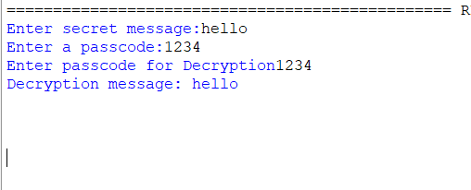
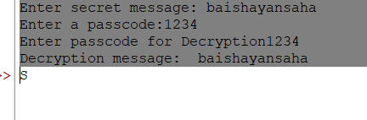
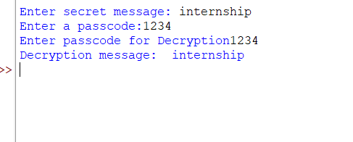
Results

Slide 8
Conclusion
This project addresses the need for secure and covert data transmission by implementing steganography to hide secret messages within images. Using pixel-level embedding and passcode protection, it ensures that only authorized users can access the hidden information. The project is simple, lightweight, and adaptable, making it suitable for individuals, professionals, and organizations. It stands out for its stealthy data hiding and ease of use, offering a practical solution for confidential communication. Future enhancements could include advanced encryption and a graphical interface, further expanding its usability and security.

Slide 9
GitHub Link
https://github.com/Baishayansaha/aicte-python-project.git

Slide 10
Future scope(optional)
Advanced Encryption Algorithms:
Integrate stronger encryption methods (e.g., AES, RSA) to further secure the hidden message during embedding and extraction.
Graphical User Interface (GUI):
Develop a user-friendly GUI using libraries like Tkinter or PyQt to make the tool accessible to non-technical users.
Support for Multiple Image Formats:
Extend the project to work with various image formats (e.g., PNG, BMP, TIFF) beyond JPEG, increasing its versatility.
Steganalysis Resistance:
Implement more sophisticated steganography techniques (e.g., LSB with randomization, frequency domain embedding) to make the hidden data harder to detect using steganalysis tools.
Multi-Layer Security:
Combine steganography with other security measures, such as watermarking or digital signatures, to enhance data integrity and authenticity.
Cross-Platform Compatibility:
Optimize the project to run seamlessly on different operating systems (Windows, macOS, Linux) and devices (desktop, mobile).
Cloud Integration:
Enable users to upload and download encrypted images directly from cloud storage services (e.g., Google Drive, Dropbox) for easier sharing.

Slide 11
THANK YOU

